Slide 1

Phishing Awareness
Phishing is a cybercrime in which attackers attempt to steal your sensitive information like passwords and credit card numbers by posing as a trusted entity. It is a serious threat that can lead to financial loss, identity theft, and reputational damage. Phishing attacks can come in many forms, including emails, text messages, and social media posts.
by Tanmay Nimbalkar

Slide 2

Common Phishing Tactics
1
Spoofed Emails
2
Urgent Requests
These emails appear to be from a legitimate source, but the sender address is actually fake.
Phishers often create a sense of urgency by claiming that you need to act immediately to avoid losing access to your account.
3
Social Engineering
4
Fake Websites
Phishers may try to manipulate you into clicking on a malicious link by appealing to your emotions, curiosity, or fear.
Phishers create websites that look almost identical to legitimate websites to trick you into entering your credentials.

Slide 3
Identifying Phishing Attempts
Check Sender's Email Address
Look for Grammar and Spelling Errors
Hover Over Links Before Clicking
Make sure the email address is from the company or organization it claims to be from.
Phishing emails are often poorly written and contain grammatical or spelling errors.
The actual link may be different from the displayed text.

Slide 4
Protecting Yourself from Phishing
Be Skeptical
1
Be cautious about unsolicited emails, texts, or social media messages, especially those that ask for personal information.
2
Verify Information
If you receive a suspicious email or message, contact the company or organization directly to verify the request.
Use Strong Passwords
3
Use unique, strong passwords for all your online accounts.
4
Enable Two-Factor Authentication
This adds an extra layer of security by requiring you to enter a code from your phone or email in addition to your password.
Keep Software Updated
5
Install the latest software updates, which often include security patches.

Slide 5
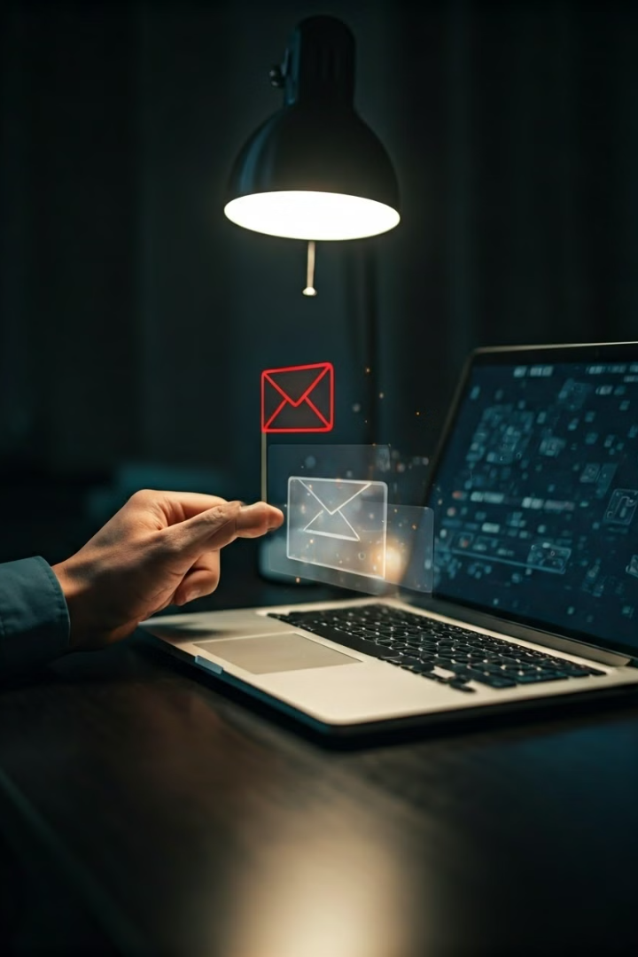



Reporting Phishing Incidents
Report to the Company
If you receive a phishing email, report it to the company it claims to be from.
Report to Law Enforcement
You can also report phishing incidents to your local law enforcement agency or the FBI.
Report to Anti-Phishing Organizations
Several organizations specialize in combating phishing, such as the Anti-Phishing Working Group (APWG).

Slide 6

Phishing Prevention Best Practices
Employee Training
Strong Password Policies
Regular training on phishing awareness can help employees identify and avoid phishing attempts.
Enforce the use of strong, unique passwords and two-factor authentication for all employees.
Email Filtering
Security Awareness Campaigns
Use email filtering software to block known phishing emails before they reach employees' inboxes.
Run regular campaigns to raise awareness of phishing threats and promote best practices.

Slide 7

Educating Employees on Phishing
Understand Phishing Tactics
Explain common tactics used by phishers to trick users.
Identify Suspicious Emails and Messages
Provide examples of phishing emails and teach employees how to spot the red flags.
Practice Safe Clicking Habits
Encourage employees to hover over links before clicking and to be cautious about clicking on links in unsolicited emails or messages.
Report Phishing Attempts
Explain the importance of reporting any suspected phishing attempts to the appropriate channels.

Slide 8





Ongoing Phishing Awareness Efforts
Regular Training
Stay Up-to-Date
Email Campaigns
Phishing Simulations
Schedule periodic training sessions on phishing awareness to keep employees informed about the latest threats and best practices.
Stay informed about the latest phishing trends and tactics by subscribing to industry newsletters and security blogs.
Send regular email campaigns to employees to reinforce phishing awareness messages and provide tips on how to stay safe.
Conduct simulated phishing attacks to test employees' ability to identify and report phishing attempts.

